Slide 1


CS 5/7320 Artificial Intelligence Search with Uncertainty AIMA Chapters 4.3-4.5
Slides by Michael Hahsler with figures from the AIMA textbook
This work is licensed under a Creative Commons Attribution-ShareAlike 4.0 International License.

Slide 2
Types of uncertainty we consider for now*
Nondeterministic Actions: Outcome of an action in a state is uncertain.
No observations: Sensorless problem
Partially observable environments: The agent does not know in what state the environment is.
Exploration: Unknown environments and Online search
* we will quantify uncertainty with probabilities later.

Slide 3
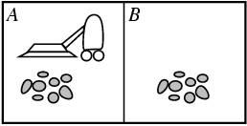
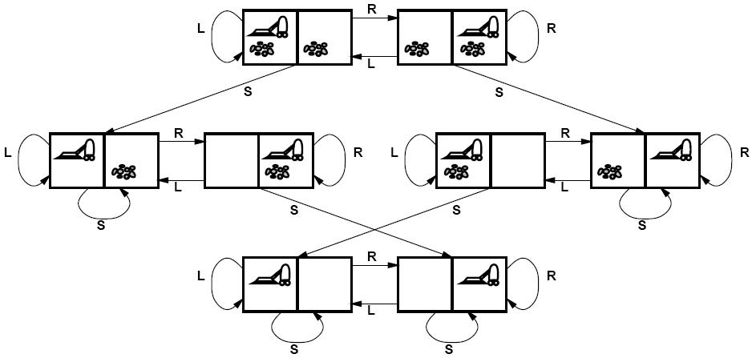
Remember: Solving search problems under Certainty
No Uncertainty
Deterministic actions with known transition model $$Result\left(s_{1},a\right)=s_{4}$$
Deterministic actions with known transition model 𝑅𝑒𝑠𝑢𝑙𝑡(𝑠_1,𝑎)=𝑠_4
Full observability (we have sensors to see the whole environment)
State space: A state completely describes the environment and agent
Initial state
Goal states
Solution of the planning phase is a sequence of actions also called a plan that can be blindly followed: [Suck, Right, Suck]

Slide 4
Consequence of Uncertainty
Solution is typically not a fixed precomputed plan (sequence of actions), but a conditional plan (also called strategy or policy) that depends on percepts.

Slide 5

Nondeterministic Actions

Slide 6
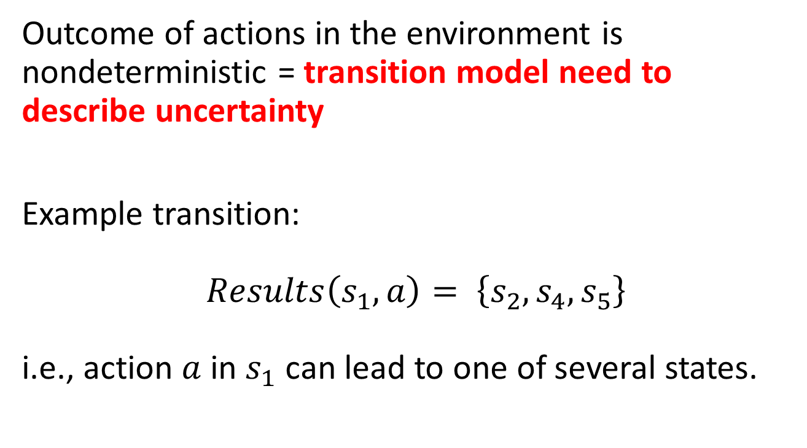
Nondeterministic Actions
Outcome of actions in the environment is nondeterministic = transition model need to describe uncertainty
Example transition: $Results\left(s_{1},a\right)= \left\{s_{2},s_{4},s_{5}\right\}$ i.e., action $a$ in $s_{1}$ can lead to one of several states.

Slide 7
Example: Erratic Vacuum World
Regular fully-observable vacuum world, but the action ‘suck’ is more powerful and nondeterministic:
On a dirty square: cleans the square and sometimes cleans dirt on adjacent squares as well.
On a clean square: sometimes deposits some dirt on the square.

Slide 8
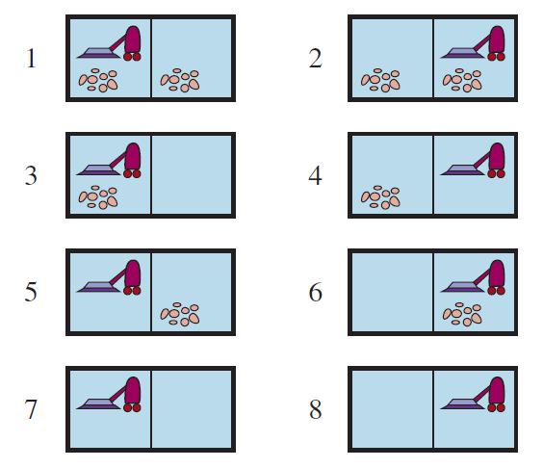

Example: Erratic Vacuum World
$Results\left(1, Suck\right)= \left\{5, 7\right\}$
Start State
Goal states
We need a conditional plan
[Suck, if State = 5 then [Right, Suck] else []]

Slide 9
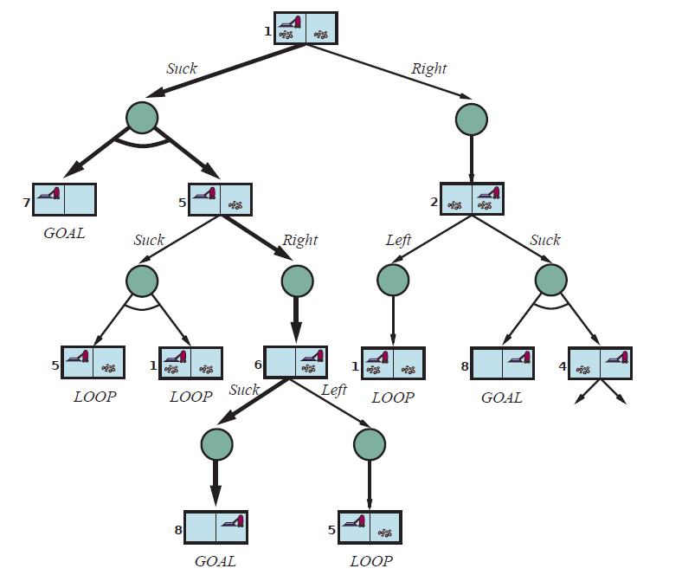
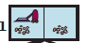

Finding a Cond. Plan: AND-OR Search Tree
Suck
OR node (choose one action)
OR
AND node (all possible outcomes)
AND
Right
Suck
Solution is shown with bold arrows:
[Suck, if State = 5 then [Right, Suck] else []]
Solution is a subtree that
has only GOAL leaf nodes
specifies one action at each OR node (state)
includes every outcome of AND nodes
LOOP: No need to continue search. Solution is the same as above.

Slide 10
AND-OR Tree search: Idea
Descend the tree by trying an action in each OR node and considering all resulting states of the AND nodes.
Remove branches (actions) if we cannot find a subtree below that leads to only goal nodes. (see failure in the code on the next slide).
Stop when we find a subtree that only has goal states in all leaf nodes (loop nodes can be ignored).
Construct the conditional plan that represents the subtree.
Suck
Right
LOOP: No need to continue search. Solution is the same as above.
Suck
[Suck, if State = 5 then [Right, Suck] else []]

Slide 11
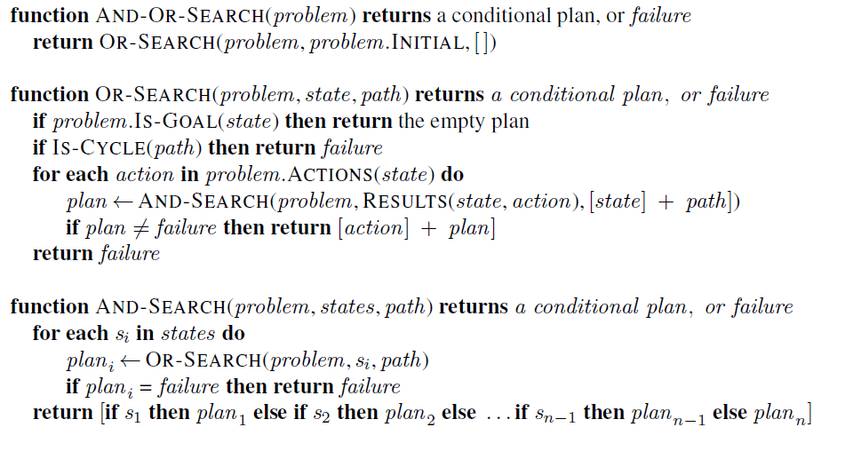
AND-OR Recursive DFS Algorithm
= nested If-then-else statements
path is only maintained for cycle checking!
// don’t follow loops using path.
// try all possible actions
// fail means we found no action that leads to // a goal-only subtree
// try all possible outcomes, none can fail! // (= belief state)
Notes:
The DFS search tree is implicitly created using the call stack (recursive algorithm).
DFS is not optimal! BFS and A* search can be used to find better solutions (e.g., smallest subtree).

Slide 12
Use of Conditional Plans
The conditional plan can be used in a model-based reflex agent.
Example: After the initial action “suck”
Agent
Step
Program
1
[Suck,
if State = 5 then
[Right,
Suck]
else
[]
]
2
Agent’s State
3
Step 2
4
4b

Slide 13

Search with no Observations
Using Actions to “Coerce” the World into Known States

Slide 14
No Observations
Sensorless problem = unobservable environment also called a conformant problem.
Why is this useful?
Example: Doctor prescribes a broad-band antibiotic instead of performing time-consuming blood work for a more specific antibiotic. This saves time and money.
Basic idea: Find a solution (a sequence of actions) that works (reasonably well) from any state and then just blindly execute it (open loop system).

Slide 15

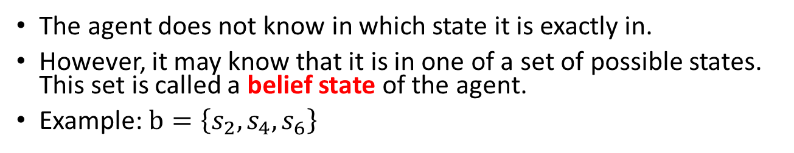

Belief State
?
?
?
The agent does not know in which state it is exactly in.
However, it may know that it is in one of a set of possible states. This set is called a belief state of the agent.
Example: $b=\left\{s_{2},s_{4},s_{6}\right\}$
$$b$$

Slide 16
Actions to Coerce the World into States
?
?
?
Actions can reduce the number of possible states.
Example: Deterministic vacuum world. Agent does not know its position and the dirt distribution.
Initial belief state {1,2,3,4,5,6,7,8}
right
Goal states

Slide 17
Actions to Coerce the World into States
?
?
?
Actions can reduce the number of possible states.
Example: Deterministic vacuum world. Agent does not know its position and the dirt distribution.
suck

Slide 18
Actions to Coerce the World into States
?
?
?
The action sequence [right, suck, left, suck] coerces the world into the goal state 7. It works from any initial state!
There are no observations so there is no need for a conditional plan.
[right, suck, left, suck]

Slide 19
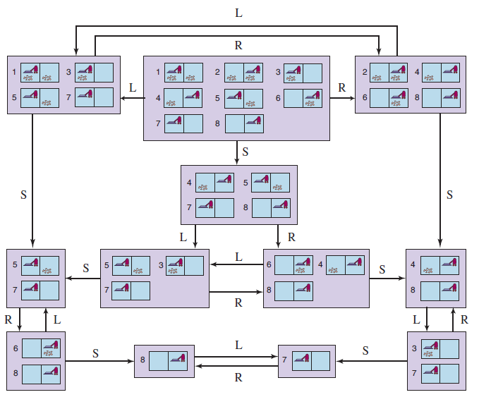
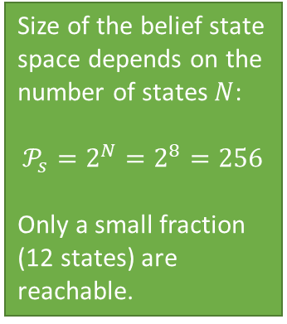
Example: The reachable belief-state space for the deterministic, sensorless vacuum world
?
?
?
Size of the belief state space depends on the number of states $N$:
$$𝒫_{s}=2^{N}=2^{8}=256$$
Only a small fraction (12 states) are reachable.
Initial belief state
No observations, so we get a solution sequence from an initial belief state:
[Right, Suck, Left, Suck]

Slide 20
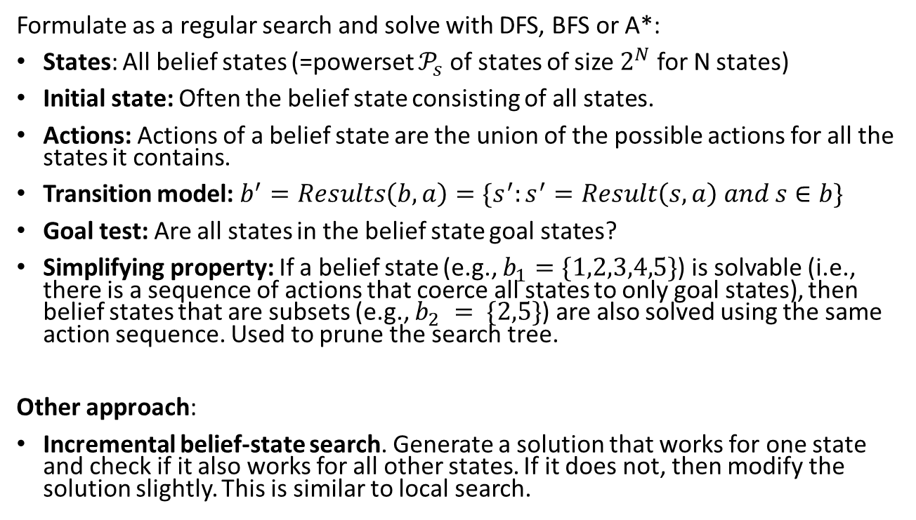
Finding a Solution Sequence
Note: State space size makes this impractical for larger problems!
Formulate as a regular search and solve with DFS, BFS or A*:
States: All belief states (=powerset $𝒫_{s}$ of states of size $2^{N}$ for N states)
Initial state: Often the belief state consisting of all states.
Actions: Actions of a belief state are the union of the possible actions for all the states it contains.
Transition model: $b^{′}=Results\left(b, a\right)=\{s^{′}:s^{′}=Result\left(s, a\right) and s∈b\}$
Goal test: Are all states in the belief state goal states?
Simplifying property: If a belief state (e.g., $b_{1}=\{1,2,3,4,5\}$) is solvable (i.e., there is a sequence of actions that coerce all states to only goal states), then belief states that are subsets (e.g., $b_{2} = \{2,5\}$) are also solved using the same action sequence. Used to prune the search tree.
Other approach:
Incremental belief-state search. Generate a solution that works for one state and check if it also works for all other states. If it does not, then modify the solution slightly. This is similar to local search.

Slide 21
Case Study
3m
1m
2m
x
Goal
location
The agent can move up, down right, left.
The agent has no sensors and does not know its current location.
1. Can you navigate to the goal location? How?
2. What would you need to know about the environment?
3. What type of agent can do this?
8m
Agent
Notes:
Move 3m left and 8m up (wall stops the agent). Move 2m left and 1m down.
Dimensions of the room. Agent needs to be able to measure the distance it goes. Wall needs to stop the agent and keep it in place.
Model-based reflex agent.

Slide 22

Partially Observable Environments
Using Observations to Learn About the State

Slide 23
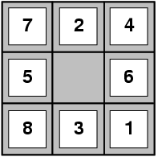
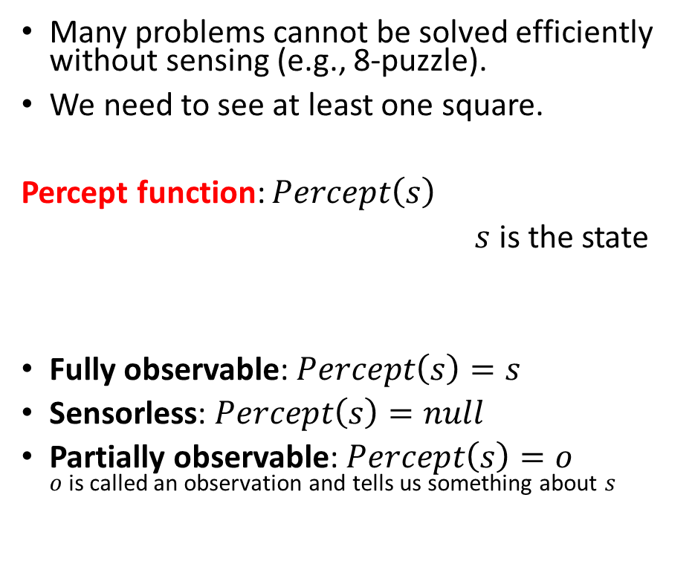
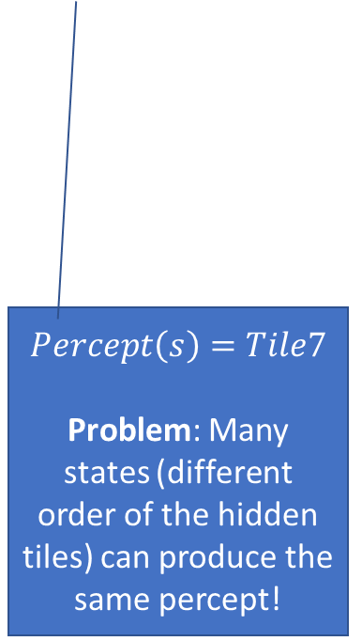
Percepts and Observability
Many problems cannot be solved efficiently without sensing (e.g., 8-puzzle).
We need to see at least one square.
Percept function: $Percept\left(s\right)$
$s$ is the state
Fully observable: $Percept\left(s\right)=s$
Sensorless: $Percept\left(s\right)=null$
Partially observable: $Percept\left(s\right)=o$ $o$ is called an observation and tells us something about $s$
$$Percept\left(s\right)=Tile7$$
Problem: Many states (different order of the hidden tiles) can produce the same percept!

Slide 24

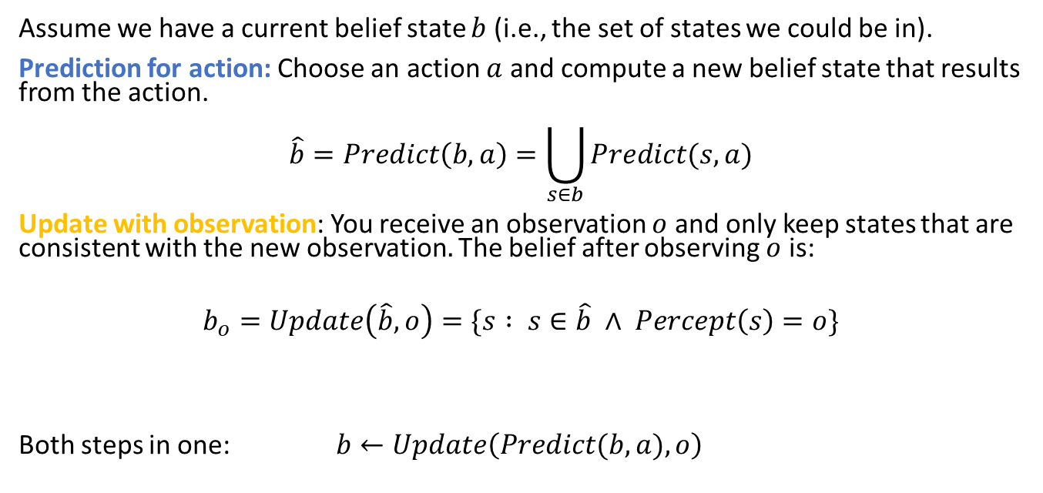
Use Observations to Learn About the State
Prediction for action $a$
Prediction for action 𝑎
Update with observation $o$
Update with observation 𝑜
$$b$$
Agents choose an action and then receive an observation.
Idea: Observations can be used to learn about the agent’s state.
Assume we have a current belief state $b$ (i.e., the set of states we could be in).
Prediction for action: Choose an action $a$ and compute a new belief state that results from the action.
$$\hat{b}=Predict\left(b,a\right)=\bigcup_{s∈b}{Predict(s,a)}$$
Update with observation: You receive an observation $o$ and only keep states that are consistent with the new observation$.$ The belief after observing $o$ is:
$$b_{o}=Update\left(\hat{b},o\right)=\{s : s∈\hat{b} ∧ Percept\left(s\right)=o\}$$
Both steps in one: $b←Update\left(Predict(b,a),o\right)$

Slide 25
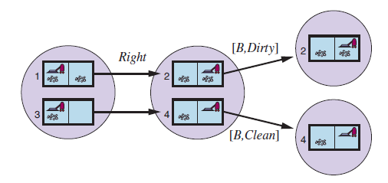


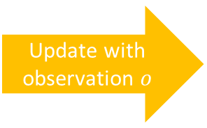
Example: Deterministic local sensing vacuum world
?
Prediction for action $a$
Prediction for action 𝑎
Update with observation $o$
Update with observation 𝑜
Predict for actions a
Update with observation $o$
$$b$$
[R,Dirty]
?
?
$$b←Update\left(Predict\left( b , a \right), o \right)$$
$$Update\left(Predict\left(\left\{1,3\right\},Right\right),[R,Dirty]\right)=\{2\}$$

Slide 26
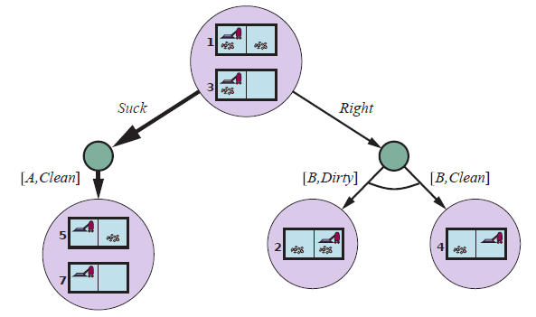
Solving Partially Observable Problems
Use an AND-OR tree of belief states to create a conditional plan
Initial
belief state
OR
[L,Clean]
AND
[R,Dirty]
[R,Clean]
AND
Solution: [Suck, Right, if b = {6} then Suck else []]

Slide 27
Solving Partially Observable Problems
Use an AND-OR tree to create a conditional plan
predict
OR
update
[L,Clean]
AND
[R,Dirty]
[R,Clean]
AND
Solution: [Suck, Right, if b = {6} then Suck else []]

Slide 28
Solving Partially Observable Problems
Use an AND-OR tree to create a conditional plan
predict
OR
update
[L,Clean]
AND
[R,Dirty]
[R,Clean]
AND
…
Solution: [Suck, Right, if b = {6} then Suck else []]

Slide 29
Solving Partially Observable Problems
Use an AND-OR tree to create a conditional plan
predict
OR
update
[L,Clean]
AND
[R,Dirty]
[R,Clean]
AND
…
Solution: [Suck, Right, if b = {6} then Suck else []]
b = {6} is the result of the update with o = [r, Dirty]

Slide 30
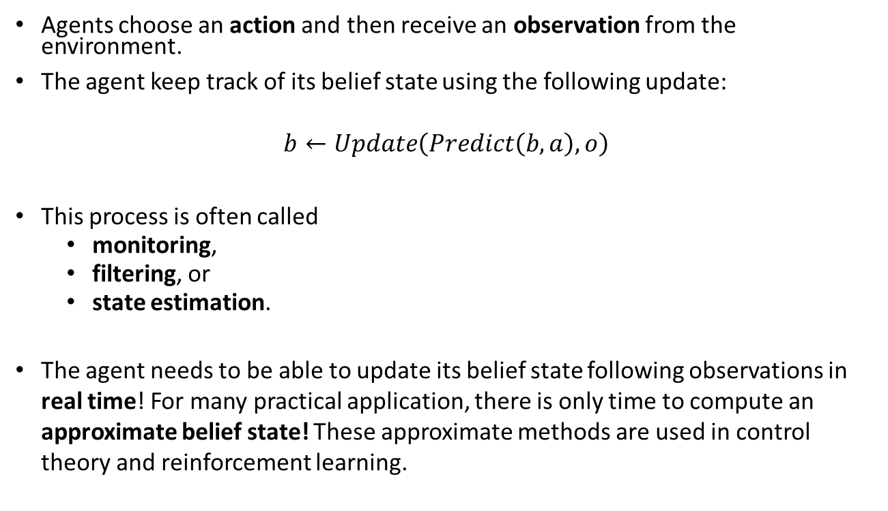
State Estimation and Approximate Belief States
Prediction for action $a$
Prediction for action 𝑎
Update with observation $o$
Update with observation 𝑜
$$b$$
Agents choose an action and then receive an observation from the environment.
The agent keep track of its belief state using the following update:
$$b←Update\left(Predict\left(b,a\right),o\right)$$
This process is often called
monitoring,
filtering, or
state estimation.
The agent needs to be able to update its belief state following observations in real time! For many practical application, there is only time to compute an approximate belief state! These approximate methods are used in control theory and reinforcement learning.

Slide 31
Case Study
Partially Observable 8-Puzzle

Slide 32
Partially Observable 8-Puzzle
Give a problem description for each step.
States:
Initial state:
Actions:
Transition model:
Goal test:
Percept function:
The problem can be solved using an AND-OR Tree, but is there an easier solution?
What type of agent do we use?
What algorithms can be used?
Notes:
Like the observable problem, but the percept function is Percept(s) = top-left corner tile.
Cycle all tiles through the window and remember what they are. Now it is a completely observable problem.
a) Model-based reflex agent (memory is used to keep track of hidden tiles)
B ) First a simple algorithm that moves all tiles through the window. Then use a regular search tree.

Slide 33

Exploration
Unknown Environment and Online Search

Slide 34
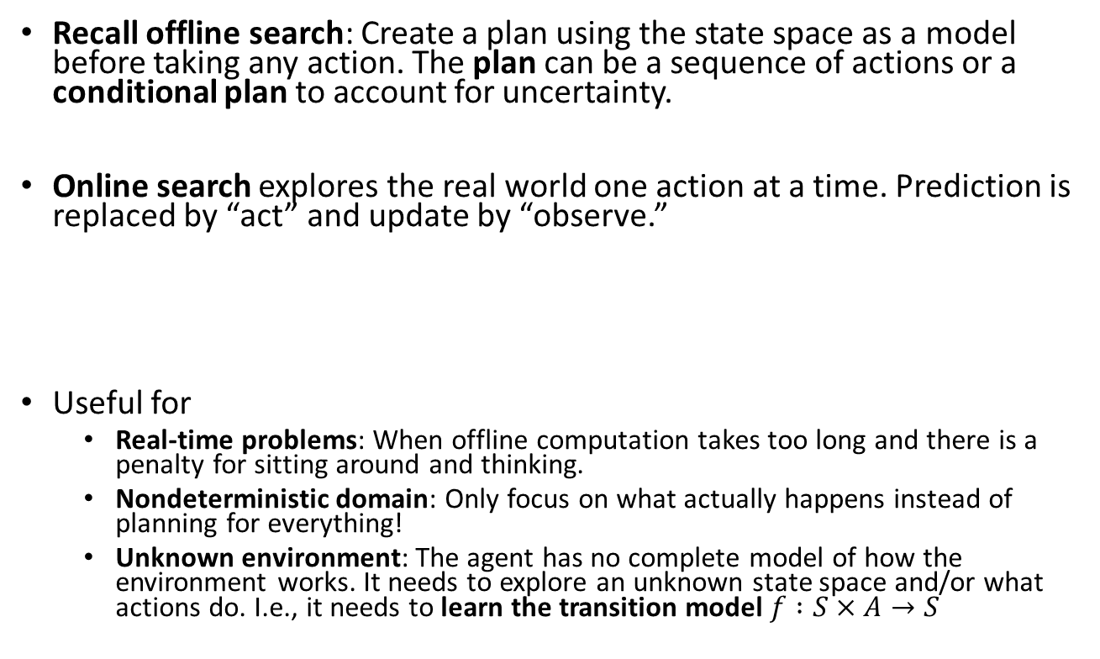
Online Search
Recall offline search: Create a plan using the state space as a model before taking any action. The plan can be a sequence of actions or a conditional plan to account for uncertainty.
Online search explores the real world one action at a time. Prediction is replaced by “act” and update by “observe.”
Useful for
Real-time problems: When offline computation takes too long and there is a penalty for sitting around and thinking.
Nondeterministic domain: Only focus on what actually happens instead of planning for everything!
Unknown environment: The agent has no complete model of how the environment works. It needs to explore an unknown state space and/or what actions do. I.e., it needs to learn the transition model $f :S×A→S$
Act
Observe
Observe
Act
Act
…

Slide 35
Design Considerations for Online Search
Knowledge: What does the agent already know about the outcome of actions? E.g., does go north and then south lead to the same location?
Safely explorable state space/world: There are no irreversible actions (e.g., traps, cliffs). At least the agent needs to be able to avoid these actions.
Exploration order: Expanding nodes in local order is more efficient if you have to execute the actions to get observations: Depth-first search with backtracking instead of BFS or A* Search.

Slide 36
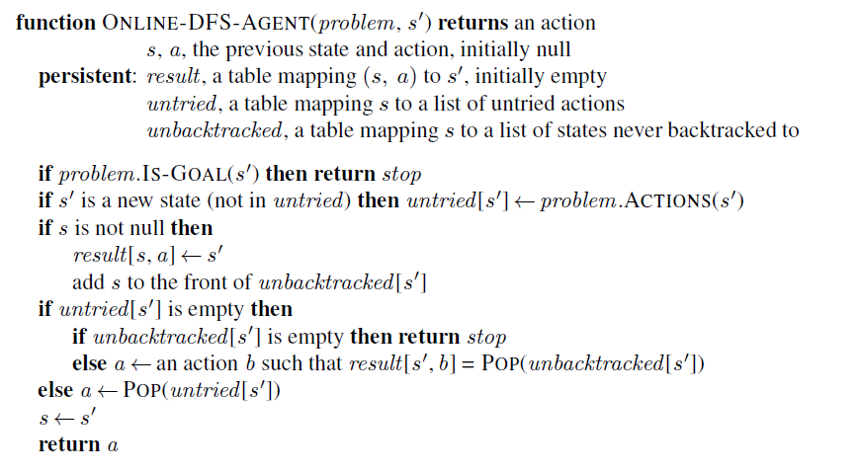
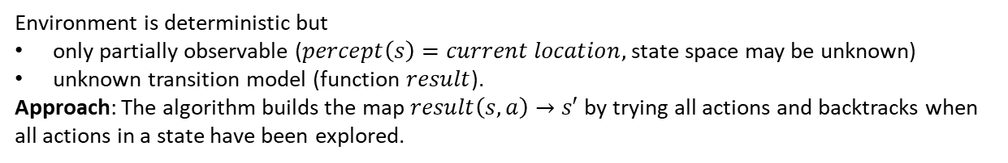
Online Search: Model-based Agent Program for Unknown Transition model
Environment is deterministic but
only partially observable ($percept\left(s\right)=current location,$ state space may be unknown)
unknown transition model (function $result$).
Approach: The algorithm builds the map $result\left(s, a\right)→s′$ by trying all actions and backtracks when all actions in a state have been explored.
Learns results function (= transition function)
Untried is the “frontier”
unbacktracked store the current path
Record the found transition
Keep breadcrumbs to go back

Slide 37

Case Study: DFS with Backtracking for a Maze
unbacktracked
We can only see adjacent squares and don’t know where the goal is!
We cannot plan but we have to explore!
We know what we have already explored.
We only need to store the path for backtracking.
Start
untried
The transition function is unknown.

Slide 38

Important concepts that you should be able to explain and use now…
Difference between solution types:
a fixed actions sequence, and
a conditional plan (also called a strategy or policy).
What are belief states?
How actions can be used to coerce the world into states.
How observations can be used to learn about the state: State estimation with repeated predict and update steps.
The use of AND-OR trees.

